Slide 1
SWE 4701
Software Metrics and Process
Lec - 2

Slide 2
Goal-Based Measurement (GBM)
The primary question in GBM:
  “What do we want to know or learn??” Instead of “What metrics should we use?”
Why so…
Because the answer depends on your goal, no fixed set of metrics is universally appropriate.
Instead of attempting to develop general-purpose measures, one has to describe an adaptable process that users can use to identify and define measures that provide insights into their own development problem.

Slide 3
GBM Process
Determine what to measure
  Identify entities
  Classifying entries to be examined
  Determining relevant goals
Determining how to measure
  Inquire about metrics
  Assign metrics

Slide 4
Identify entities
Products, process, resources [ fenton’91]
Artifacts, activities, agents [Armitage’94]
Both schemes are incomplete and haven’t enough representational power.
E.g., neither seems to deal with entities such as “ defects”
  Is a defect a product, a process or a resources?
  Is defect an artifact, activity or agent??

Slide 5
The Three Entities of Measurement
To measure software, we must categorize what we are looking at.
  Processes: Activities (What we do).
  Products: Artifacts (What we make).
  Resources: Inputs (What we use).
Process Measures
  Measurement of software development activities.
Examples:
  Duration of the testing phase.
  Effort (hours) spent designing.
  Number of requirement reviews held.
Why? To improve efficiency.
Product Measures
  Measurement of the artifacts produced.
Examples:
  Source Code (Size, Complexity).
  Design Documents (Page count).
  Test Cases (Coverage).
  Manuals (Readability).
Why? To ensure quality.
Resource Measures
  Measurement of items required to perform the process.
Examples:
  Personnel (Experience level, Salary).
  Hardware/Software tools.
  Office environment.
Why? To manage costs.

Slide 6
Types of attributes
Internal Attribute
  Attribute that can be measured entirely in terms of the process, product or resources itself separate from its behavior ( example: Size)
  Easy way to remember: “I can measure it by inspection”
More Examples:
  Size of code (lines of code, function points)
  Number of modules
  Number of defects in code (before release)
External Attribute
  Attribute that can be measured with respect to how the process, product or resource relates to its environment through its behavior. ( example: quality)
  Easy way to remember: “I need usage or behavior to measure it.”
More Examples:
  Reliability
  Usability
  Performance (response time)
  User satisfaction

Slide 7
Sample Process measures
Process Entities | Attributes | Possible Measures
development process | elapsed time | Calendar days, working days
 | milestones | Calendar dates
 | development effort | Staff-hours, days, or months
 | phase containment | Percent of total defects found in phase where introduced
 | process compliance | Percent of tasks complying with standard procedures or directives
 | performance | Number of tests passed divided by number of tests executed
test process | volume | Number of tests scheduled
 | progress | Number of tests executed; Number of tests passed

Slide 8
Sample Process measures
Process Entities | Attributes | Possible Measures
detailed design | elapsed time | calendar days, working days
 | design quality | defect density: number of design defects found in down-stream activities divided by a measure of product size, such as function points or physical source lines of code.
maintenance | cost | dollars per year
 |  | staff-hours per change request
Change request backlog | size | number of change requests awaiting service
 |  | estimated effort (staff-hours) for pending requests

Slide 9
Sample Product measures
Product Entities | Attributes | Possible Measures
system | size | number of modules
 |  | number of bubbles in a data-flow diagram
 |  | number of function points
 |  | number of physical source lines of code
 |  | number of memory bytes or words required (or allocated)
 | defect density | defects per KLOC ;
 |  | defects per function point
module | length | physical source lines of code
 |  | logical source statements
 | percent reused | ratio of unchanged physical lines to total physical lines, comments and blanks excluded

Slide 10
Sample Product measures
Product Entities | Attributes | Possible Measures
unit | number of linearly independent flowpaths | McCabe's complexity
document | length | number of pages
line of code | statement type | type names
 | how produced | name of production method
 | programming language | language name
defect | type | type names
 | origin | name of activity where introduced
 | severity | an ordered set of severity classes
 | effort to fix | staff-hours

Slide 11
Sample Resource measures
Resource Entities | Attributes | Possible Measures
Assigned staff | team size | number of people assigned
 | experience | years of domain experience; years of programming experience
CASE tools | type | name of type
 | Is used? | yes/no (a binary classification)
time | start date, due date | calendar dates
 | elapsed time | days
 | Execution time | CPU clocks

Slide 12
GQM Approach
The Goal-Question-Metric (GQM) approach is a method for creating process metrics based on an organization’s or business’s goals.
it helps you decide what to measure by first defining your goal, then asking questions about that goal, and finally choosing metrics to answer those questions.
References:
V.R. Basili and D. Weiss (1984), A Methodology for Collecting Valid Software Engineering Data, IEEE Trans. Software Engineering, vol. 10, pp. 728-738.
V.R. Basili and H.D. Rombach (1988), The Tame Project: Towards Improvement-Oriented Software Environments, IEEE Trans. Software Engineering, vol. 14, pp. 758-773.

Slide 13
Basili’s GQM Process Model (1992)
Phase 1: Developing a set of corporate, division, and project goals.
Phase 2: Generating questions that define those goals as completely as possible in a quantifiable way.
Phase 3: Specifying measures (metrics) needed to be collected to answer those questions and to track process and product conformance to the goals.
Phase 4: Developing mechanisms for data collection.
Phase 5: Collecting, validating, and analyzing the data in real time to provide feedback for corrective action and recommendations for future improvements.

Slide 14
Basili’s GQM Process Model (1992)
Phase | Main Activity | Outcome
Goal Definition | Define corporate, division, and project goals aligned with business objectives | Clearly structured and aligned goals
Question Generation | Develop measurable questions that clarify and quantify goals | Set of goal-oriented questions
Metric Specification | Identify metrics to answer questions and measure process/product performance | Defined list of metrics
Data Collection Mechanism | Design procedures, tools, and responsibilities for collecting data | Measurement plan and data collection system
Data Collection & Analysis | Collect, validate, analyze data and provide feedback for improvement | Insights, corrective actions, and improvement recommendations

Slide 15
STTI-KL’s GQM Process Model (1995)
Phase 1- Prestudy: Collecting information relevant to introducing the program.
Phase 2- Identification: Deriving GQM goals from informal organizational goals.
Phase 3- Production of GQM plan: Interviewing to find implicit knowledge, merging results, and reviewing the plan.
Phase 4- Production of measurement plan: Defining procedures and checking consistency with the project plan.
Phase 5- Collection and validation: Storing data according to defined procedures.
Phase 6- Analysis: Interpreting data through feedback sessions.
Phase 7- Packaging: Recording results and experiences gained.

Slide 16
STTI-KL’s GQM Process Model (1995)
Phase | Main Activity | Main Outcome
Prestudy | Understand organization | Initial understanding of context, problems, and improvement areas
Identification | Define GQM goals | Structured and formally defined GQM goals
GQM Plan | Define questions & metrics | Complete GQM model (Goals–Questions–Metrics)
Measurement Plan | Define procedures | Detailed measurement plan aligned with project activities
Collection | Gather data | Valid and organized measurement data
Analysis | Interpret results | Insights, conclusions, and improvement decisions
Packaging | Document experience | Documented lessons learned and reusable knowledge

Slide 17
Solingen’s GQM Process Model
Phase 1- Planning: Establishing teams, selecting improvement areas/projects, creating plans, and training.
Phase 2- Definition: Defining goals, process models, questions, hypotheses, and metrics; checking consistency and producing plans.
Phase 3- Data collection: Defining steps/forms/tools, training, and building a measurement support system (MSS).
Phase 4- Interpretation: Feedback sessions, reporting results, and cost-benefit analysis of the program.

Slide 18
Solingen’s GQM Process Model
Phase | Focus | Main Outcome
Planning | Preparation | Team & project selected
Definition | Define GQM model | Goals, questions, metrics
Data Collection | Gather data | Measurement database
Interpretation | Analyze & improve | Reports & decisions

Slide 19
SEI’s GQM (1996)
The Software Engineering Institute (SEI) defined a goal-driven model that uses a ten-step pipeline style.
It focuses on the whole process of converting a business goal into specific measurement goals and refining them into a formal measurement plan.
This process model is easy to understand and follow in that it works in a pipeline style, which means that the output of a step is the input of the next step.

Slide 20
SEI’s GQM (1996)
Step | Main Activity | Purpose / Outcome
1 | Identify business goals | Understand what the organization wants to achieve
2 | Identify what you want to learn | Clarify improvement or information needs
3 | Define measurement goals (GQM goals) | Convert business goals into structured GQM goals
4 | Develop questions | Break goals into measurable questions
5 | Specify metrics | Define data needed to answer questions
6 | Identify data collection strategy | Decide how, when, and by whom data will be collected
7 | Implement data collection system | Develop tools, forms, databases
8 | Collect and validate data | Gather accurate and reliable data
9 | Analyze and interpret results | Determine whether goals are achieved
10 | Package and communicate results | Provide feedback and recommendations for improvement

Slide 21

Comparison of GQM Process Models
The following table summarizes the comparison of different Goal-Question-Metric models based on their strengths.
GQM Process Model | Simplicity | Clearness | Completeness
Process model defined by Basili (1992) | X
Process model defined by STTI-KL (1995) |  | X
Process model defined by Solingen (1999) |  | X | X
Goal-driven process defined by SEI (1996) | X | X | X

Slide 22
Goal-Question-Metric Paradigm
In general, the GQM approach provides a framework involving three steps:
  Goal: List the major goals of the development or maintenance project.
  Question: Derive from each goal the questions that must be answered to determine whether the goals are being met.
  Metric: Decide what must be measured in order to be able to answer the questions adequately.

Slide 23
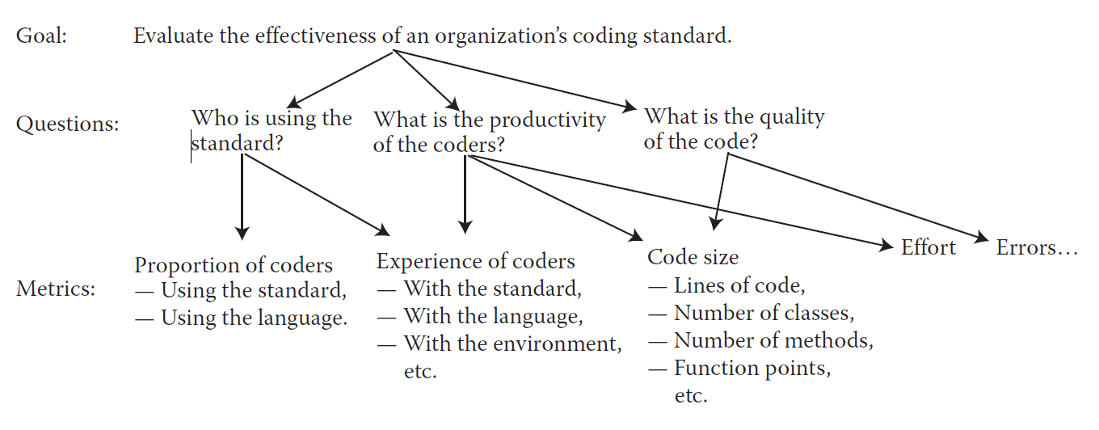
GQM Example

Slide 24
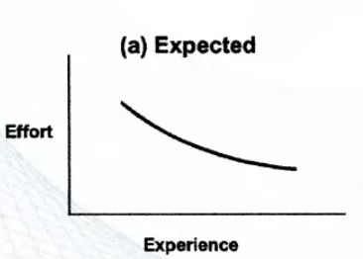
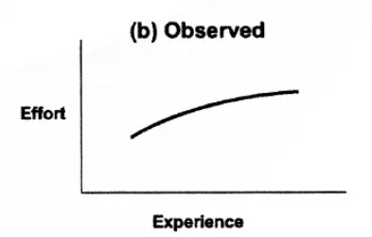
GQM Data analysis
Suppose that you propose to collet data to examine the effect of programmer experience on development effort. You are expecting that effort (hours) will decrease as the developer's experience increases (a). But your collected data shows effort increasing with increasing experience. (b)
Why do we get these sorts of unexpected results???
May be due to : Technology factor, under-staffing, rapid changes in requirements……

Slide 25
Case Study 1: AT&T’s GQM
Overall Goal: Better code base inspection
  Goal A: Better inspection planning [Plan]
  Goal B: Better monitor and control of the code [Control]
  Goal C: Improving code inspection [Improve]

Slide 26
Case Study 1: AT&T’s GQM - Goal A
Goal A: Better inspection planning [Plan]
Q1: How much does the inspection process cost?
  M1-1: Average effort per KLOC
  M1-2: Percentage of re-inspection
Q2: How much calendar time does the inspection process take?
  M2-1: Average effort per KLOC
  M2-2: Total KLOC inspected

Slide 27
Case Study 1: AT&T’s GQM - Goal B
Goal B: Better monitor and control of the code [Control]
Q1: What is the quality of the inspection software?
  M1-1: Average fault detected per KLOC
  M1-2: Average inspection rate
  M1-3: Average preparation rate
Q2: To what degree did the staff conform to procedure?
  M2-1: Average inspection rate
  M2-2: Average preparation rate
  M2-3: Average lines of code inspected
  M2-4: Percentage of re-inspection
Q3: What is the status of the inspection process?
  M3: Total KLOC inspected

Slide 28
Case Study 1: AT&T’s GQM - Goal C
Goal C: Improving code inspection [Improve]
Q1: How effective is the inspection process?
  M1-1: Defect removal efficiency
  M1-2: Average fault detected per KLOC
  M1-3: Average inspection rate
  M1-4: Average preparation rate
  M1-5: Average lines of code inspected
Q2: What is the productivity of the inspection process?
  M2-1: Average effort per fault detected
  M2-2: Average inspection rate
  M2-3: Average preparation rate
  M2-4: Average lines of code inspected

Slide 29
Case Study 2: HP’s GQM
Three Main Goals:
Goal A: Maximize customer satisfaction
Goal B: Minimize engineering effort and schedule
Goal C: Minimize defects

Slide 30
Case Study 2: HP’s GQM – Goal A
Goal A: Maximize customer satisfaction
QA1: What are the attributes of customer satisfaction?
  MA1: Functionality, usability, reliability, performance, supportability.
QA2: What are the key indicators of customer satisfaction?
  MA2: Survey, quality function deployment (QFD).
QA3: What aspects result in customer satisfaction?
  MA3: Survey, QFD.
QA4: How satisfied are customers?
  MA4: Survey, interview record, number of customers severely affected by defects.
QA5: How many customers are affected by a problem?
  MA5: Number of duplicate defects by severity.
QA6: How many problems are affecting the customer?
  MA6-1: Incoming defect rate
  MA6-2: Open critical and serious defects
  MA6-3: Defect report/fix ratio
  MA6-4: Post-release defect density

Slide 31
Case Study 2: HP’s GQM – Goal A
Goal A: Maximize customer satisfaction
QA7: How long does it take to fix a problem?
  MA7-1: Mean time to acknowledge problem
  MA7-2: Mean time to deliver solution
  MA7-3: Scheduled vs. actual delivery
  MA7-4: Customer expectation of time to fix
QA8: How does installing a fix affect the customer?
  MA8-1: Time customers operation is down
  MA8-2: Customers effort required during installation
QA9: Where are the bottlenecks?
  MA9: Backlog status, time spent doing different activities

Slide 32
Case Study 2: HP’s GQM – Goal B
Goal B: Minimize engineering effort & schedule
QB1: Where are the worst rework loops in the process?
  MB1: Person-months by product-component-activity.
QB2: What are the total life-cycle maintenance and support costs for the product?
  MB2-1: Person-months by product-component-activity.
  MB2-2: Person-months by corrective, adaptive, perfective maintenance.
QB3: What development methods affect maintenance costs?
  MB3: Pre-release records of methods and post-release costs.

Slide 33
Case Study 2: HP’s GQM – Goal B
Goal B: Minimize engineering effort & schedule
QB4: How maintainable is the product as changes occur?
  MB4-1: Incoming problem rate
  MB4-2: Defect density
  MB4-3: Code stability
  MB4-4: Complexity
  MB4-5: Number of modules changed to fix one detect
QB5: What will process monitoring cost and where are the costs distributed?
  MB5: Person-months and costs
QB6: What will maintenance requirements be?
  MB6-1: Code stability, complexity, size
  MB6-2: Pre-release defect density

Slide 34
Case Study 2: HP’s GQM – Goal C
Goal C: Minimize Defects
QC1: What are key Indicators of process health and how are we doing?
  MC1: Release schedule met, trends of defect density, serious and critical defects.
QC2: What are high-leverage opportunities for preventive maintenance?
  MC2-1: Defect categorization
  MC2-2: Code stability
QC3: Are fixes effective with less side effects?
  MC3: Defect report/fix ratio
QC4: What is the post-release quality of each module?
  MC4: Defect density, critical and serious defects.

Slide 35
Case Study 2: HP’s GQM – Goal C
Goal C: Minimize Defects
QC5: What are we doing right?
  MC5-1: Defect removal efficiency
  MC5-2: Defect report/fix ratio
QC6: How do we know when to release?
  MC6-1: Predicted defect detection and remaining defects.
  MC6-2: Test coverage.
QC7: How effective is the development process in preventing defects?
  MC7: Post-release defect density
QC8: What can we predict will happen post-release based on pre-release data?
  MC8: Corrections between pre-release complexity, defect density, stability, and customer survey data.
QC9: What defects are getting through and what are their causes?
  MC9: Defect categorization

Slide 36
Exercise
Your organization has just completed a software process assessment. One of the findings was that your projects are delivering software functions and documentation on time, but customers are not as satisfied as you would like them to be. The process improvement team has identified "improving customer satisfaction" as one of its primary goals. You are a project manager, and you need a set of measures that will help your project make progress toward this goal.
Devise subgoals to achieve this goal and for each subgoal, formulate appropriate questions and identify metrics to measure progress.
Subgoal 1: Improve Alignment with Customer Requirements
Subgoal 2: Improve Perceived Software Quality
Subgoal 3: Improve Communication with Customers
Subgoal 4: Improve Responsiveness to Customer Issues
Subgoal 5: Improve Usability and User Experience
Subgoal 6: Improve Post-Delivery Support and Documentation

Slide 37
1: Improve Alignment with Customer Requirements
Questions
Are customer requirements clearly understood?
How often are requirements changed after development starts?
Are delivered features aligned with customer expectations?
Metrics
Number of requirement changes after baseline
Percentage of implemented requirements approved by customer
Number of customer change requests after delivery
Customer acceptance rate at delivery

Slide 38
2: Improve Perceived Software Quality
Questions
How many defects are visible to customers?
How severe are the reported defects?
How often does the software fail in operation?
Metrics
Number of customer-reported defects
Defect density in released software
Severity distribution of defects
Failure rate during operation

Slide 39
3: Improve Communication with Customers
Questions
How frequently do we communicate with customers?
Are customers informed about project status and risks?
Are customer concerns acknowledged on time?
Metrics
Number of customer meetings per month
Frequency of status reports shared
Average response time to customer inquiries
Customer feedback on communication effectiveness

Slide 40
4: Improve Responsiveness to Customer Issues
Questions
  How quickly are customer issues resolved?
  Are issues prioritized correctly?
  Do customers feel their issues are handled effectively?
Metrics
  Mean time to resolve customer-reported issues
  Percentage of issues resolved within SLA
  Issue backlog size
  Customer satisfaction score after issue resolution

Slide 41
5: Improve Usability and User Experience
Questions
  Is the software easy to learn and use?
  Do users require frequent assistance?
  Are users satisfied with the interface?
Metrics
  Number of usability-related complaints
  Average task completion time
  User error rate
  User satisfaction survey score

Slide 42
6: Improve Post-Delivery Support and Documentation
Questions
  Is the documentation clear and helpful?
  How often do customers request clarification?
  Is support effective after release?
Metrics
  Number of documentation-related support requests
  Customer rating of documentation quality
  Average support response time
  Customer satisfaction with post-delivery support

Slide 43
GQ(I)M

Slide 44
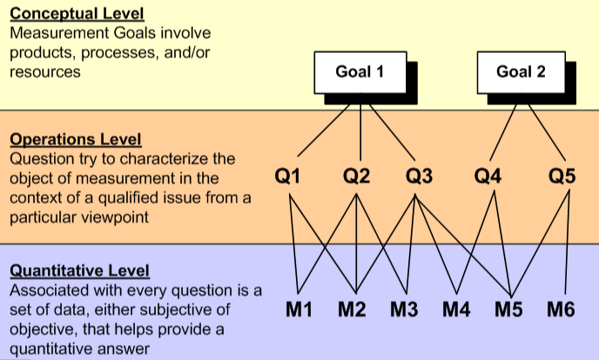
Classic GQM Approach
Developed by Victor Basili:
Goal: High-level objective
Question: What to understand about the goal
Metric: Data to answer questions
If you can not measure , you can not improve

Slide 45
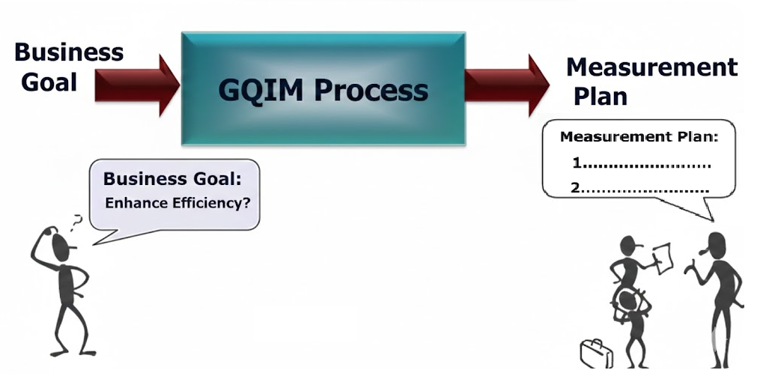
GQ(I)M Concept
A methodology to convert a business goal into a measurement plan

Slide 46
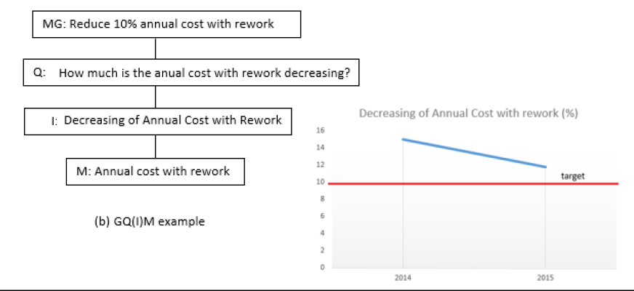
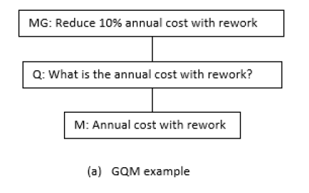
Evolution to GQ(I)M
Adds Indicator layer for performance insights (e.g., KPIs/dashboards)
Bridges questions to actionable metrics
Aligns better with modern standards (ISO/IEC/IEEE 15939)
Focuses on executable structures from informal goals

Slide 47
Three Precepts of GQ(I)M
Measurement goals derive from business goals
Evolving mental models provide context/focus
Translates informal goals into executable measurement structures
Measurement goals derive from business goals
Evolving mental models provide context/focus
Translates informal goals into executable measurement structures

Slide 48
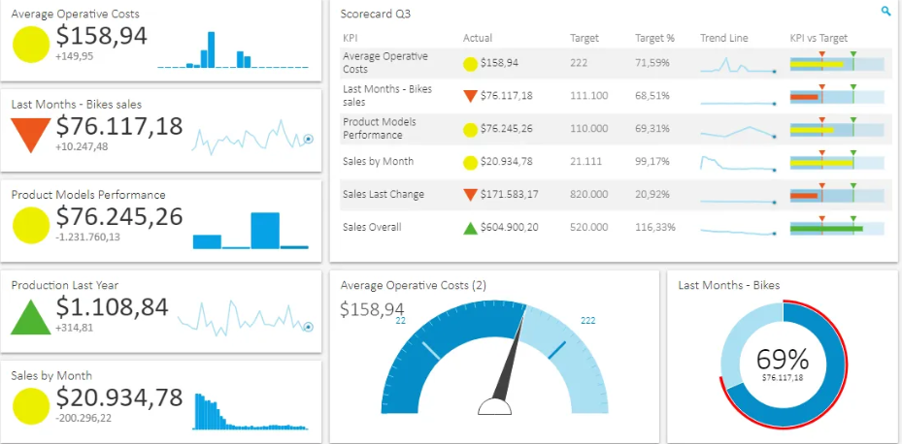
GQ(I)M Structure Overview
Goal → Question → Indicator → Metric
Indicators provide insight (e.g., dashboards)
Metrics are operational data definitions
The GQ(I)M method begins with identifying business goals and breaking them down into manageable subgoals.
It ends with a plan for implementing well-defined measures and indicators that support the goals.
It can also maintain traceability back to the business goals.

Slide 49

GQ(I)M Process Steps
Identify business goals
Identify what you want to know or learn
Identify subgoals
Identify entities and attributes related to subgoals
Formalize measurement goals

Slide 50
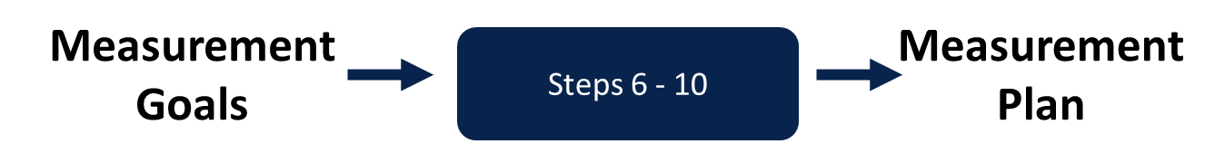
GQ(I)M Process Steps
Identify quantifiable questions and indicators that will be used to achieve measurement goals.
Identify data elements that will be collected to construct the indicators to answer questions.
Define measures to be used, and make these definitions operational.
Identify actions that will be taken to implement the measures.
Prepare a plan for implementing the measures.

Slide 51

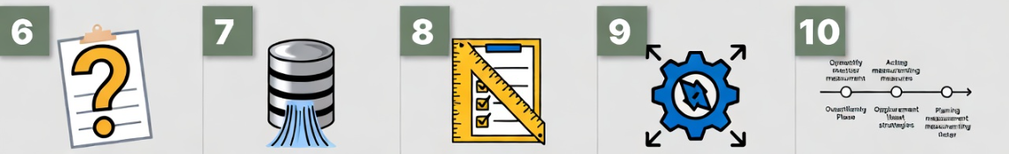
GQ(I)M Process Steps
Identify business goals
Identify what you want to know or learn
Identify subgoals
Identify entities and attributes related to subgoals
Formalize measurement goals
Identify quantifiable questions and indicators that will be used to achieve measurement goals
Identify data elements that will be collected to construct the indicators to answer questions.
Define measures to be used, and make these definitions operational.
Identify actions that will be taken to implement the measures
Prepare a plan for implementing the measures.

Slide 52
Step 1: Identify Business Goals
Start with high-level strategic business objectives
What does the organization want to achieve overall?
Goals should be aligned with the company strategy and priorities
Avoid vague statements — make them specific and outcome-focused
Example:
Business Goal: "Reduce overall software development process costs by 20% within 12 months while maintaining or improving product quality (measured by defect rates)"

Slide 53
Step 2: Identify What You Want to Know or Learn
Define the knowledge gaps or insights needed to achieve the goal
Ask: "What do we need to understand to make informed decisions?"
Focus on critical questions that reveal root causes or opportunities
Example:
What activities consume the most development time/cost?
How does team productivity vary across projects?
Which factors most strongly influence defect rates and rework effort?

Slide 54
Step 3: Identify Subgoals
Break the main business goal into smaller, focused sub-objectives
Subgoals should be more specific and actionable
Use hierarchy or tree structure to show relationships
Example:
Subgoal 1: Identify high-cost development activities
Subgoal 2: Improve team productivity per story point
Subgoal 3: Reduce time spent on defect fixing
Subgoal 4: Minimize impact of scope changes

Slide 55
Step 4: Identify Entities and Attributes Related to Subgoals
Entities = objects of interest (processes, people, products, artifacts)
Attributes = measurable characteristics or properties of those entities
Map what can actually be observed/measured
Example:
Entity: Development activities → Attributes: hours spent, cost per hour
Entity: Development team → Attributes: size, story points delivered, velocity
Entity: Defects → Attributes: count, fix time, severity
Entity: Requirements → Attributes: change requests, scope creep count

Slide 56
Step 5: Formalize Measurement Goals
Turn informal goals into precise, structured measurement goals
Use classic GQM template: "Purpose: [characterize/evaluate/improve] the [object] from [viewpoint] perspective in order to [reason]"
Example:
"To characterize the cost structure of the software development process from the engineering manager's perspective in order to identify high-cost areas for improvement."
"To evaluate team productivity from the development team's perspective in order to improve efficiency."

Slide 57
Step 6: Identify Quantifiable Questions and Indicators
Formulate specific, answerable questions linked to measurement goals
Define indicators (KPIs) that provide insight/direction
Indicators should be actionable and dashboard-friendly
Example:
Question: "Which activities consume the most effort?" → Indicator: % of total hours by activity type
Question: "How productive is the team?" → Indicator: Story points delivered per team member per sprint
Question: "How much effort is spent on defects?" → Indicator: Defect fix hours / total development hours

Slide 58
Step 7: Identify Data Elements
List raw data items needed to calculate indicators
Specify sources (tools, logs, surveys, etc.)
Ensure data is collectible and reliable
Example:
Time logs per activity (from Jira)
Story points completed per sprint (from backlog tool)
Defect reports and resolution times (from bug tracker)
Team size and sprint duration (from HR/project management tool)

Slide 59
Step 8: Define Measures Operationally
Create precise, unambiguous definitions for each measure
Include formula, unit, collection method, responsible person
Make it repeatable and verifiable
Example:
Measure: Activity Cost → Formula: (Hours logged in activity × Hourly rate), Unit: USD, Collected via: Time-tracking tool export weekly
Measure: Team Velocity → Formula: Sum of story points completed in sprint / Number of team members, Unit: Points/person/sprint

Slide 60
Step 9: Identify Actions to Implement Measures
Define concrete actions triggered by indicators/metrics
Actions should lead to goal achievement
Include who, what, when
Example:
If defect fix ratio > 25% → Action: Implement mandatory code reviews & pair programming
If activity cost for testing > 30% → Action: Increase test automation coverage to 70%
If velocity drops → Action: Conduct retrospective & address blockers

Slide 61
Step 10: Prepare a Plan for Implementing the Measures
Create a realistic rollout plan
Include timeline, responsibilities, tools, training, and review cadence
Monitor adoption and adjust as needed
Example:
Q1: Set up time-tracking & integrate with Jira (Owner: PM)
Q2: Train team on data entry & start weekly collection
Q3: Build dashboard & review indicators monthly
Q4: Implement first improvement actions based on data

Slide 62
Software Measurement Validation
The Problem: There is a vast number of software measures (size, cost, complexity), but they often lead to conflicting management decisions.
The Confusion: Managers see different values for the same attribute and don't know which to trust.
The Root Cause: A lack of formal validation. We often fail to check if the measure captures the "truth" of the attribute.
The Goal: To move from "intuition-based" measurement to "rigorous" validation.

Slide 63
Two Types of Validation
Validation approaches differ based on what you are doing with the data.
We must distinguish between:
  Measures (Assessment): Used to numerically characterize an existing entity (e.g., "How big is this code right now?").
  Prediction Systems: Used to predict an attribute of a future entity using a mathematical model (e.g., "How much will this project cost to finish?").
A measure is valid if it is accurate; a prediction system is valid if it correctly predicts future outcomes.

Slide 64
Validating Prediction Systems
Establishing accuracy through empirical means (comparing model performance with real-world data).
Method: Experimentation and hypothesis testing (Confirming or negating a claim).
Software predictions (cost, effort, reliability) are rarely 100% exact. They have error bounds.
Example: COCOMO might be accurate within a 20% "acceptance range.“
Stochastic vs. Deterministic:
Deterministic: Same input always yields the same output.
Stochastic: Output varies probabilistically (higher uncertainty).

Slide 65
Validating Measures
Ensuring a measure is a proper numerical characterization of an attribute by satisfying the Representation Condition.
The measure must not contradict intuitive notions. That is, If common sense says A is bigger/better/harder than B, the numbers should say the same thing.
Example:
If you combine Program A and Program B, the measured length m(A+B) must equal m(A) + m(B).
If Program A is longer than B, then m(A) > m(B).
Difficulty of Exams
Exam A is very hard
Exam B is easy
If a “difficulty score” says:
A = 3
B = 9
What will you say about this?

Slide 66
Mathematical Meaning of "Metric"
In math, "metric" = distance function with properties:
  m(x,x) = 0
  m(x,y) = m(y,x)
  Triangle inequality: m(x,z) ≤ m(x,y) + m(y,z)
Not the same as software "metrics“, we casually say metrics to mean any measure.
All mathematical metrics are measures, but not all software measures are mathematical metrics.

Slide 67
Example
Correctness as Distance
  Let:
  S = Software Specification (what we want)
  P = Program (what we built)
Our Metric : m(S, P) = correctness distance
If, Distance = 0 → program fully satisfies specification (perfect correctness)
Correctness is viewed as how far the program is from the spec
Input | Expected | Actual | Correct?
2,3 | 5 | 5 | ✔
4,5 | 9 | 8 | X
1,1 | 2 | 2 | ✔
Failed = 1 out of 3 so 33% away from perfect correctness.

Slide 68
Internal vs Wide Validity
Internal (narrow):
  Measure correctly captures attribute (e.g. LOC = size)
Wide:
  It is not only meaningful by itself, but also useful for predicting or explaining other important attributes.
  Measure + used successfully in prediction (e.g. size → effort prediction)
A measure can be useful and valid even if it cannot predict other attributes.
Being a predictor is a bonus
It is not a requirement for a measure to be “good”
Example: Temperature
Temperature tells you how hot it is now
It may not predict tomorrow’s weather
  Still a good measure
  Accurate and meaningful
  Not a predictor

Slide 69
Common Mistake – Correlation ≠ Causation
Many claim validity just because the measures correlate.
Correlation does not imply cause-effect
Example:
  In summer ice-cream sales increase also the Drowning incidents increase.
  We can find correlation. But ice-cream does not cause drowning
Software Engineering Example:
  Large programs often have more bugs
  You will find strong correlation. But Bigger size does not directly cause bugs.

Slide 70
Things to Remember
Validation is non-negotiable: Without it, we are just guessing.
Start Narrow: First, ensure your measure is internally valid (captures the attribute).
Build Theories: Only when we have rigorous measures can we build "Wide Sense" predictive models.
Complexity is the Great Challenge: Attributes like "Complexity" remain hard to validate because they are poorly defined.
Good predictive models require good measurements, and good measurements require rigorous validation — especially for abstract attributes like complexity.

